Slide 1
Building network-tolerant PWAs
Now,
Now-Now,
and Just-Now:
@mikegeyser
#DevFestZA

Slide 2


@mikegeyser

Slide 3

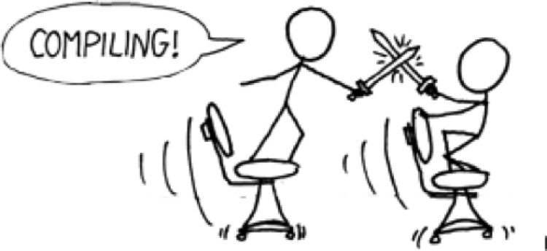
@mikegeyser

Slide 4

@mikegeyser

Slide 5


Slide 6
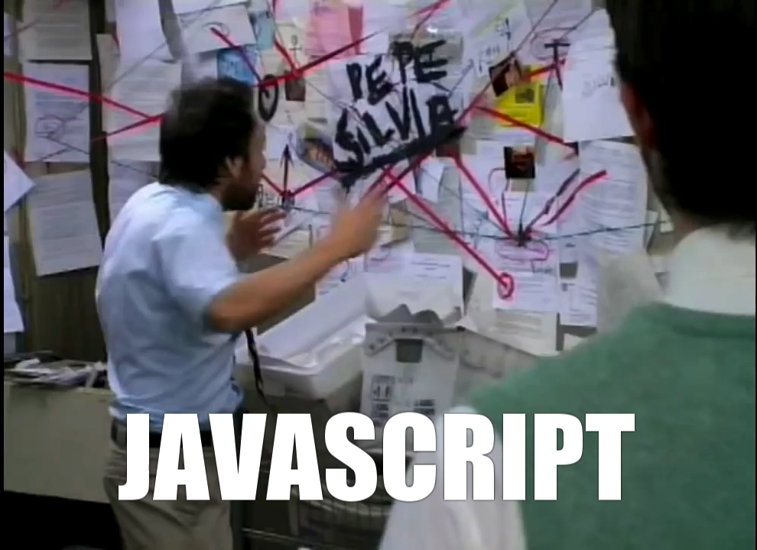

Slide 7

@mikegeyser

Slide 8

Now
Immediately! Probably…
Just-Now
Now-Now
Later?
Maybe…
Soon!
Probably…
@mikegeyser

Slide 9
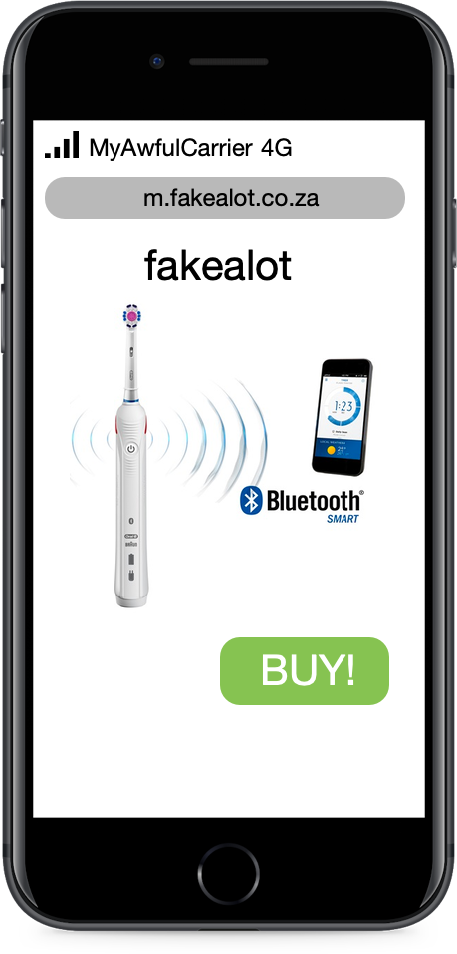

@mikegeyser

Slide 10
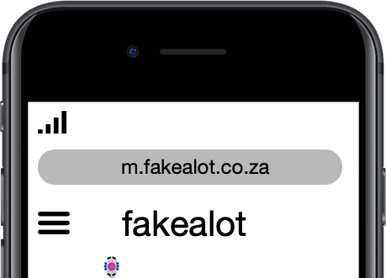
MyAwfulCarrier 4G
@mikegeyser

Slide 11
MyAwfulCarrier 3G
@mikegeyser

Slide 12
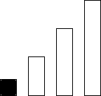
MyAwfulCarrier 3G
@mikegeyser

Slide 13
MyAwfulCarrier Edge
@mikegeyser

Slide 14
@mikegeyser

Slide 15
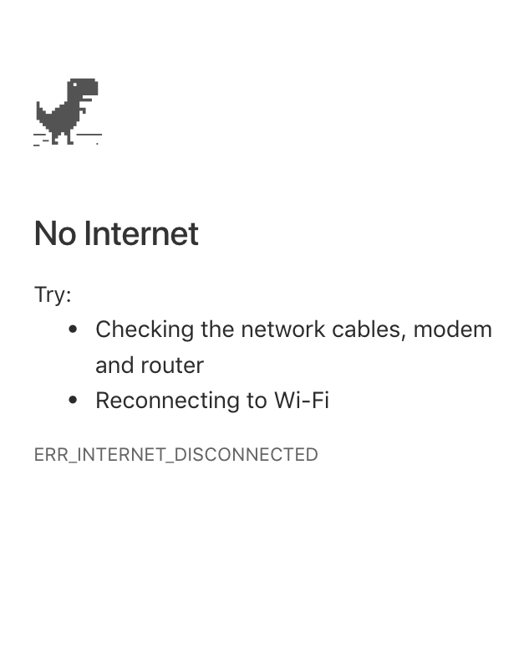
No Service
@mikegeyser

Slide 16

THIS IS WHY
WE CAN’T HAVE NICE THINGS

Slide 17
Network Tolerance
Partition tolerance
Network resilience
‘Offline first’
@mikegeyser

Slide 18
YOU KEEP USING THAT WORD
I DO NOT THINK IT MEANS WHAT
YOU THINK IT MEANS…

Slide 19
So, how do we do this?
@mikegeyser

Slide 20
Communicate state well
@mikegeyser

Slide 21

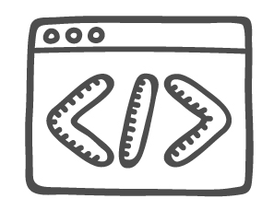

Service Worker
@mikegeyser

Slide 22


Slide 23
IndexedDB
@mikegeyser

Slide 24
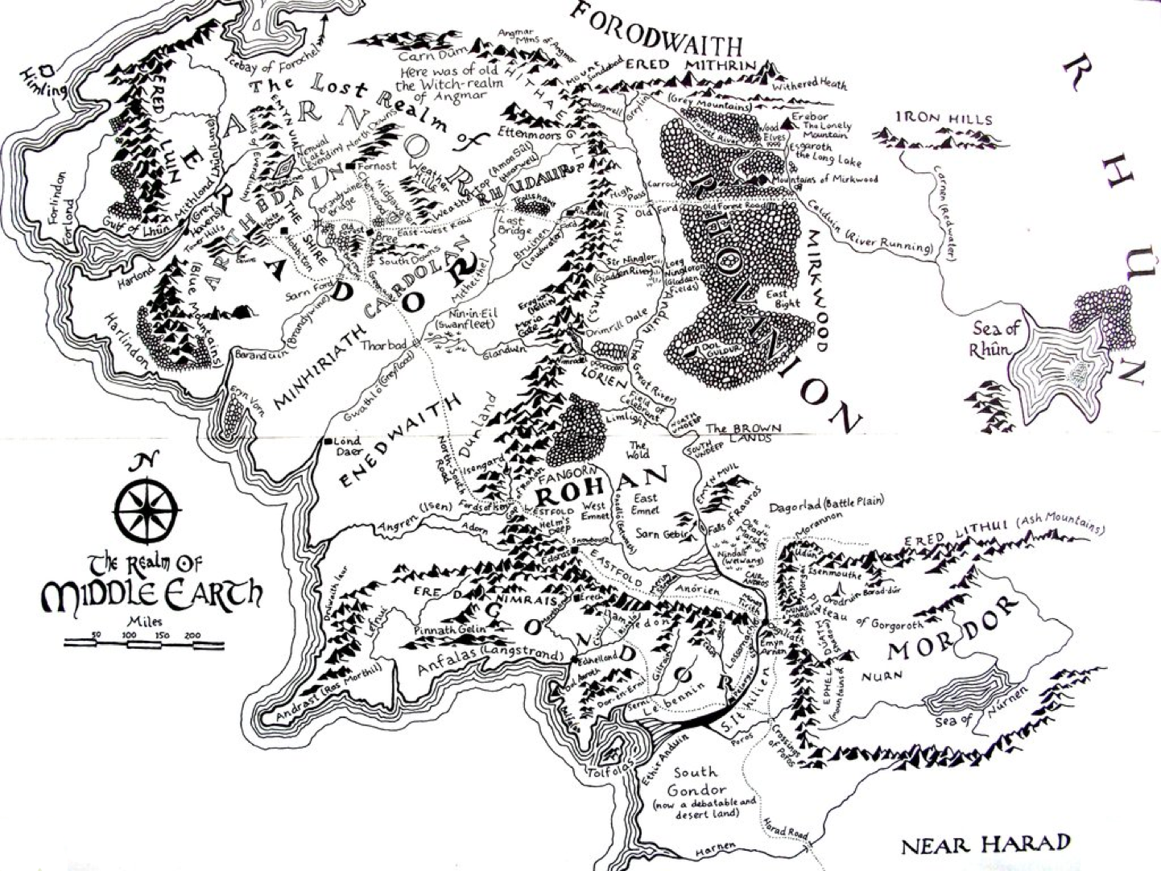

Slide 25

DEMO TIME

Slide 26
Summary
Capabilities
Expectations
Thoughtful design
Plan for offline
@mikegeyser

Slide 27
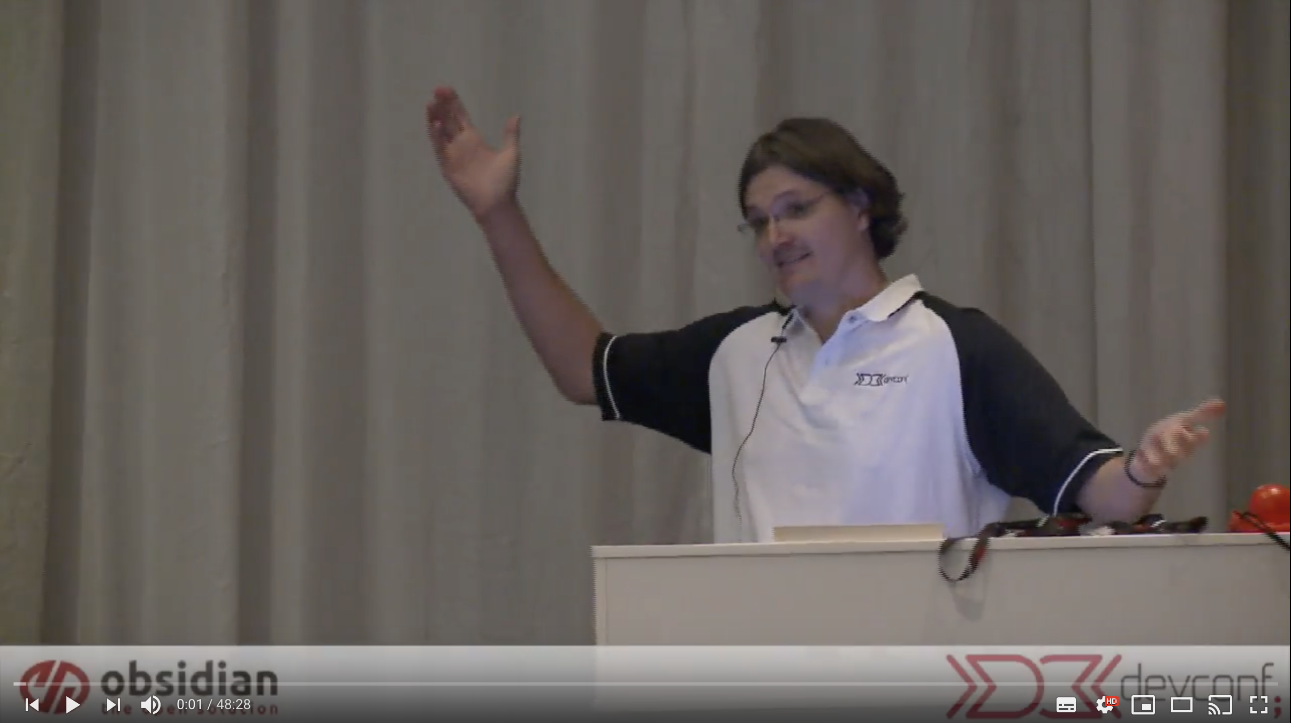
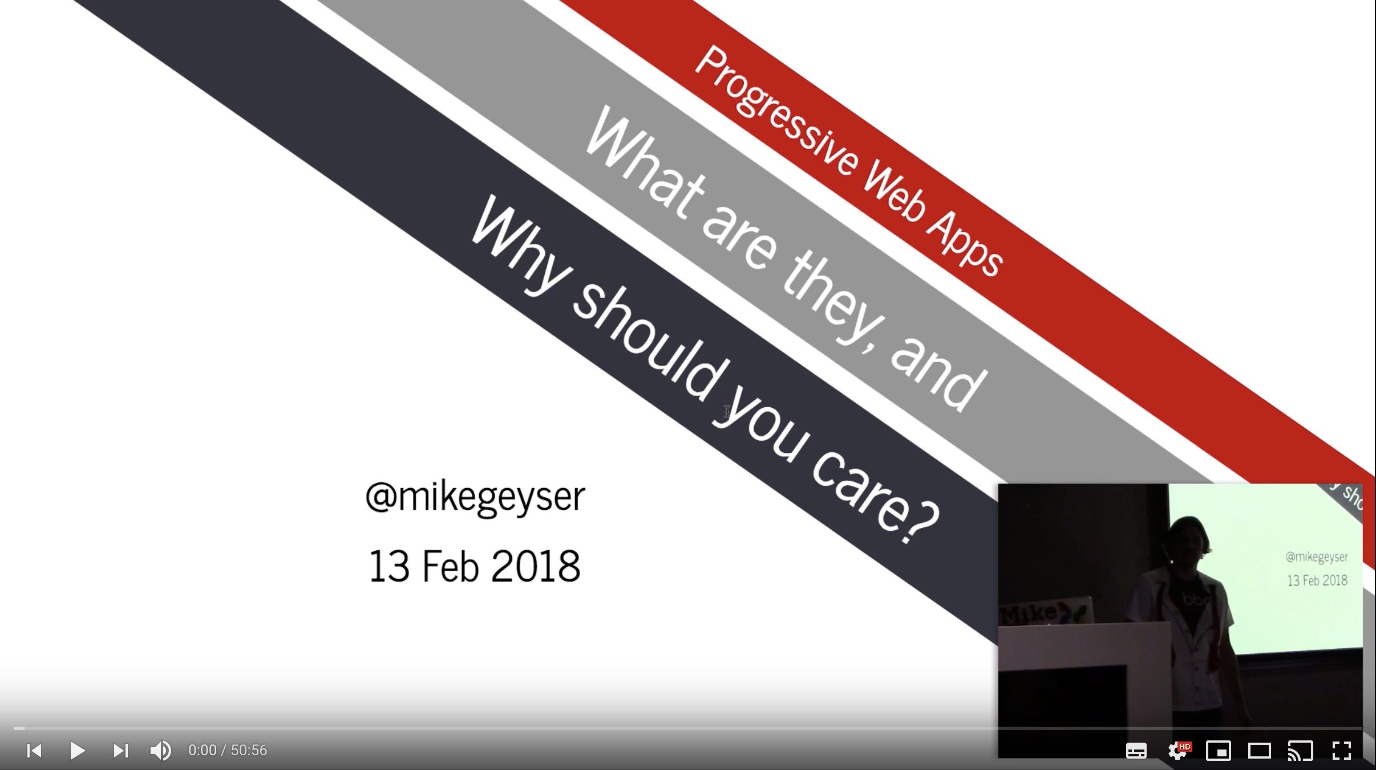
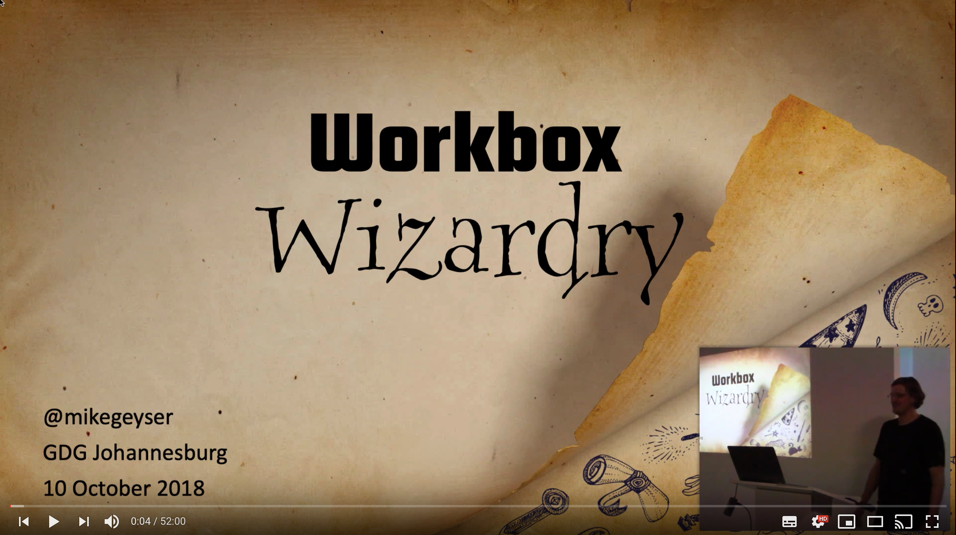
Questions?
@mikegeyser
https://goo.gl/geAwiw

